Slide 1
Figural Conventions
Circles and Ovals represent Latent Constructs
Boxes & Rectangles represent manifest (measured) variables
Single-headed lines are directional (causal) relationships represented as regression estimates
Double-headed lines are non-directional (co-occurring) relationships represented as covariance or variance estimates
Triangle used to represent means or item intercepts
statscamp.org
1

Slide 2
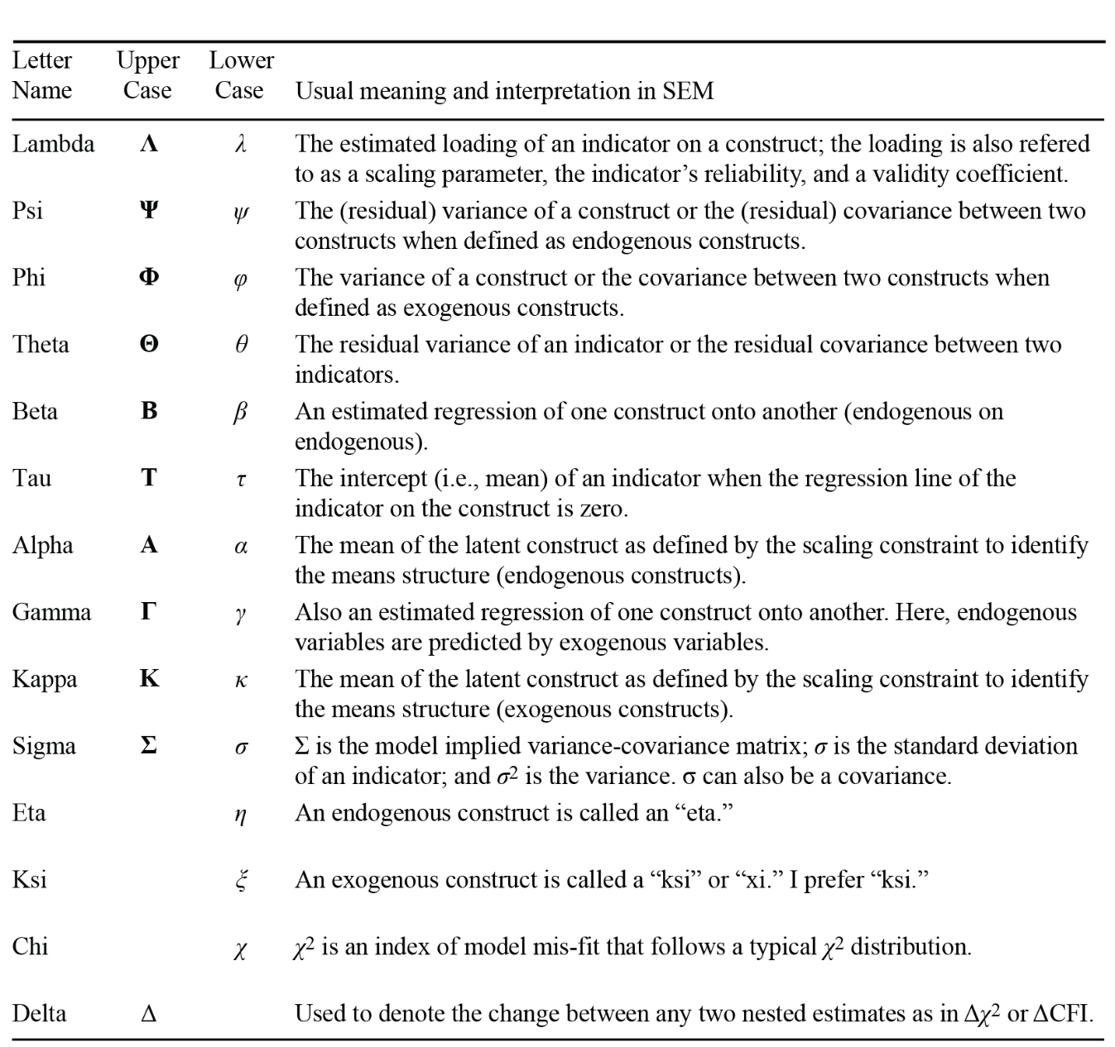
statscamp.org
2

Slide 3
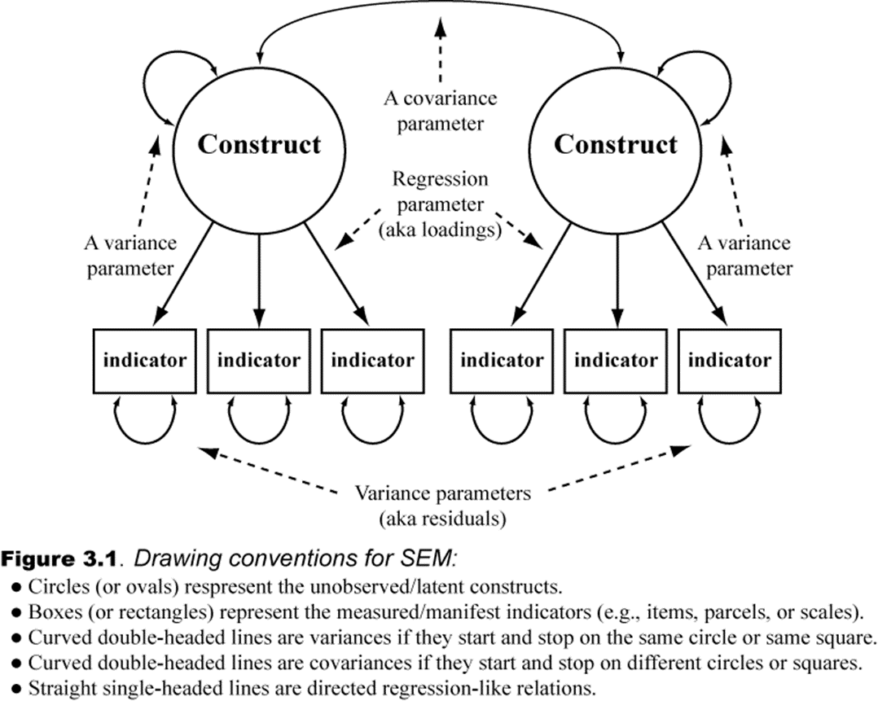
Figural Conventions
statscamp.org
3

Slide 4
A Construct is What the Indicators Share
statscamp.org
4

Slide 5
Identification - I
statscamp.org
5

Slide 6
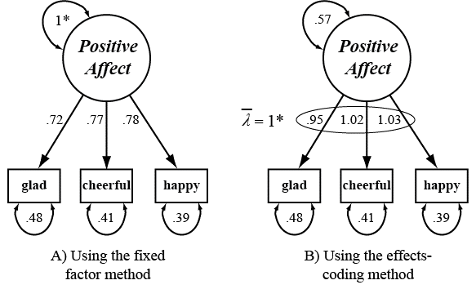
Identification - II
statscamp.org
6

Slide 7
Identification - III
statscamp.org
7

Slide 8
Identification - IV
statscamp.org
8

Slide 9
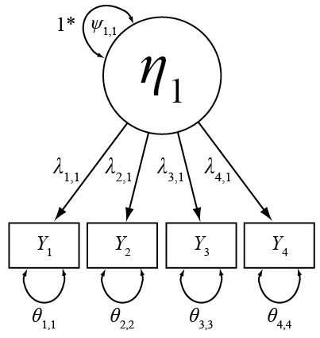
Identification - V
statscamp.org
9
Notes:
4 items could lead to bad tests in terms of fit – 3 is better for model evaluation.

Slide 10
Identification - VI
statscamp.org
10

Slide 11
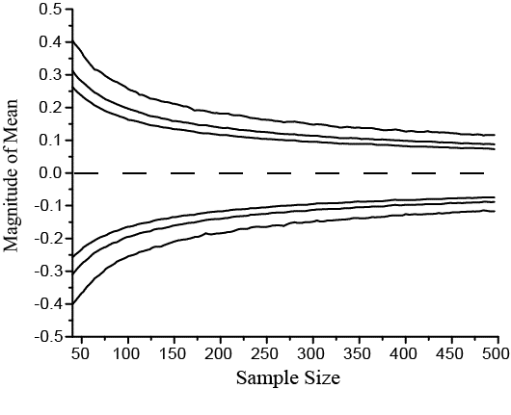
Sample Size & Sampling Variability
statscamp.org
11

Slide 12
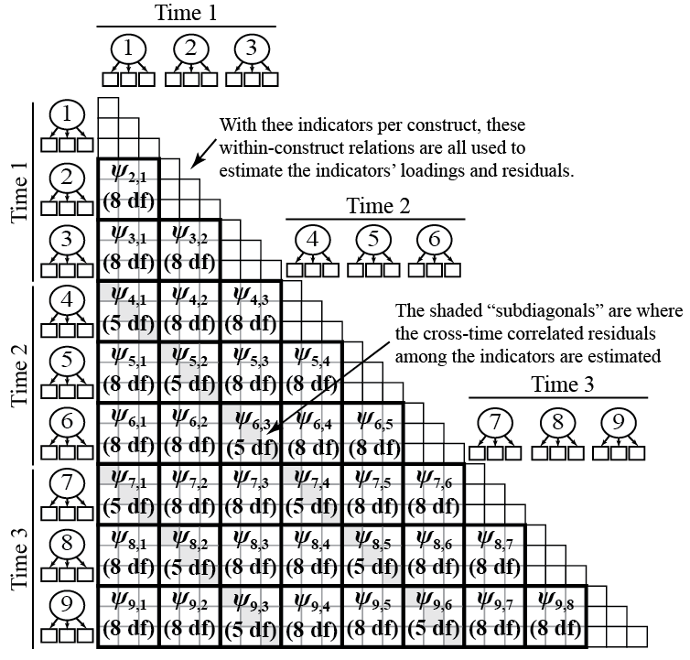
Model Degrees of Freedom
statscamp.org
12

Slide 13
Continuum of Models
Absolute fit statistics judge the distance from Perfect fit
Relative fit statistics judge the distance from Worst fit (Null)
statscamp.org
13
Notes:
13

